Slide 1
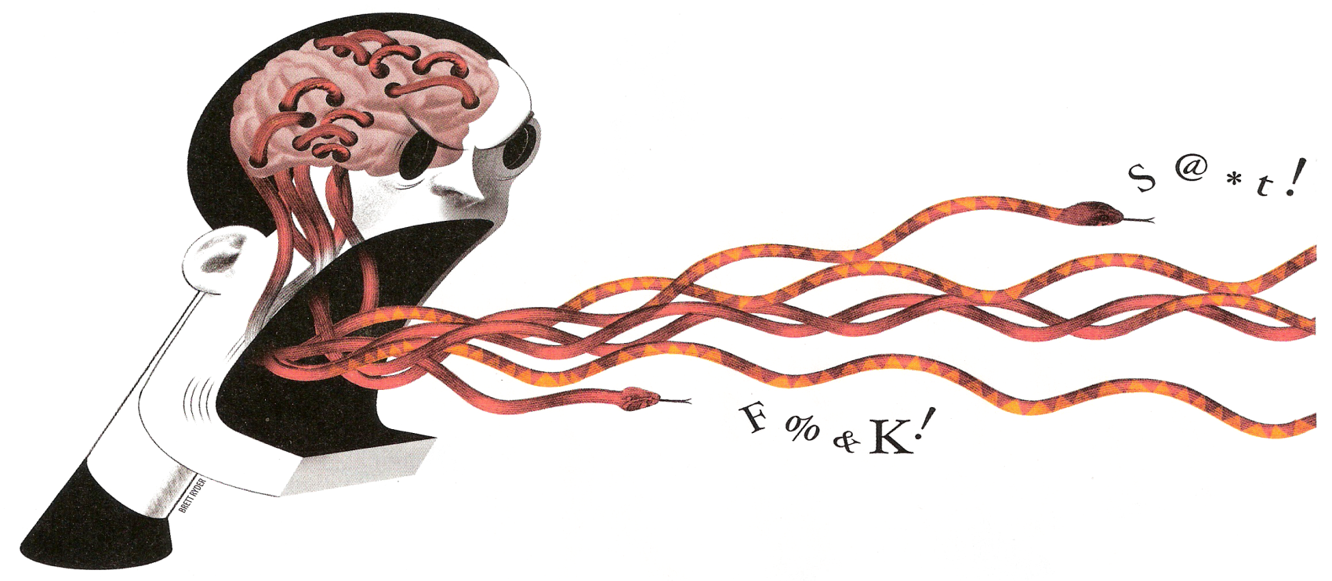
World Events are Changing Education
E-learning but not E-quality: How you learn is how to learn
Information processing issues for remote learning
YOUR BRAINS: 100 billion brain cells.....500 trillion connections.....1 million per second
Structure
1. Brain Roles 2. Sensory Preferences 3. Organising Styles - 4. Teacher Roles
Professor Rosemary Sage: rjwbsage@gmail.com

Slide 2
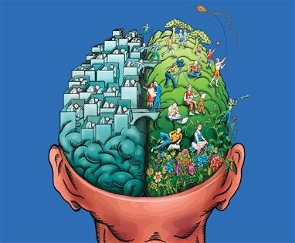
1. Brain Roles in Information Processing
The R seeing brain processes images holistically - (4-7+ yr)
The L saying/hearing brain processes words & parts (7+ yr)
Parts / facts
Holistic
understanding
analyses
synthesises
Education favours L brain learning (Sperry 1968). Students with problems have limited L or R brain growth. You cannot say what you see if the L & R brain do not connect.

Slide 3
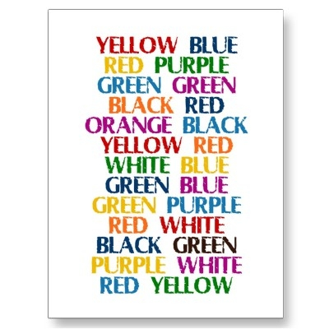
Test out your 2 brains! Do they work together?
See the word but Say the colour
Most have R (visual) or L (verbal) brain dominance, reflected in their strengths Cross-laterals with no specific dominance take longer to process information.

Slide 4

2. Organising Styles
R top down + L bottom up brain processing grasps information
R works on outline, L on detail. How do work out the image? Miller’s Puzzle (1986)
We deliver information in a preferred R or L way (50% R & 50% L) Those opposite to us have more problems understanding our talk/text. Present information for both strategies. Allow visuals to be absorbed first before explaining, to help those with problems using both brain sides together.

Slide 5
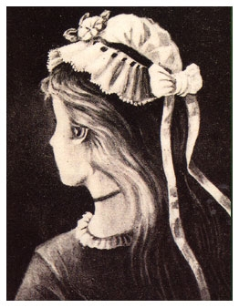
3. Sensory Preferences:Visual Processing
What do you see?...
….depends on which retina cells pick up the image & transmit it to the brain. Different cells pick up diverse colours, contrasts, back/foregrounds. Some deal with central vision – others peripheral. Images are interpreted differently by people. Teachers beware!

Slide 8
Remember!
We only give 20%
full attention
Impact of message:
7% words, 38% voice, 55% gestures, movement, context
Albert Mehrabian, 1969

Slide 9
How do we assemble information?
Imagination, association, assumptions
We must visualise to recall & understand (R brain)
The places trick:
Take an imaginary walk in your house:
Open the front door
Walk into the hall
Go to the kitchen
Climb the stairs
Enter the bathroom
Wander to the bedroom!
Now listen to the story!

Slide 10

Thinking: R brain creates possibilities – L sequences steps to goal
How can you pick the apples?
R brain
creative thinking
Seek ladder
Climb Tree
Find stick to throw
Blow apples
Seek tallest person
L brain
critical thinking
Select tallest
Target apples
Lift arms & pick
Hand round
Enjoy eating
If apples are bigger than plums
& plums bigger than currants
apples are bigger than currants

Slide 11
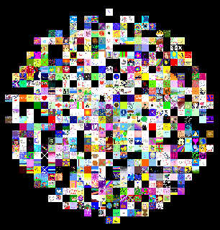
Right brain fills in information/opinion gaps in talk/text
Left brain sequences information logically
Algy met the bear
The bear met Algy
It was bulgy
The bulge was Algy
What information is missing?
In a UK city primary school - all entrants had thinking & language
2 + years below age. In senior school - 80% at 5-6 year level at age 12

Slide 12
MODEL TO ASSEMBLE INFORMATION & OPINION (Sage)
7 stages to the development of ideas
Clarity
making ideas clear
and interesting
Record: generate ideas
Recite: arrange ideas
Refer: compare ideas
Replay: sequence ideas in time
Recount: Introduce, describe, discuss
Report: Introduce, describe, discuss, reflect
Relate: setting, characters, actions ,
results, reactions
Content
ideas relevant for
audience
Conduct
impression ideas
make on others
Convention
rules governing the
exchange of ideas
5 conversation moves must be in place for narrative thinking & structure
1. Follows conversation thread 2. Asks Questions 3. Answers Questions 4. Assembles
& contributes ideas 5. Shows maintenance behaviour – eye contact, smile, head nod

Slide 13
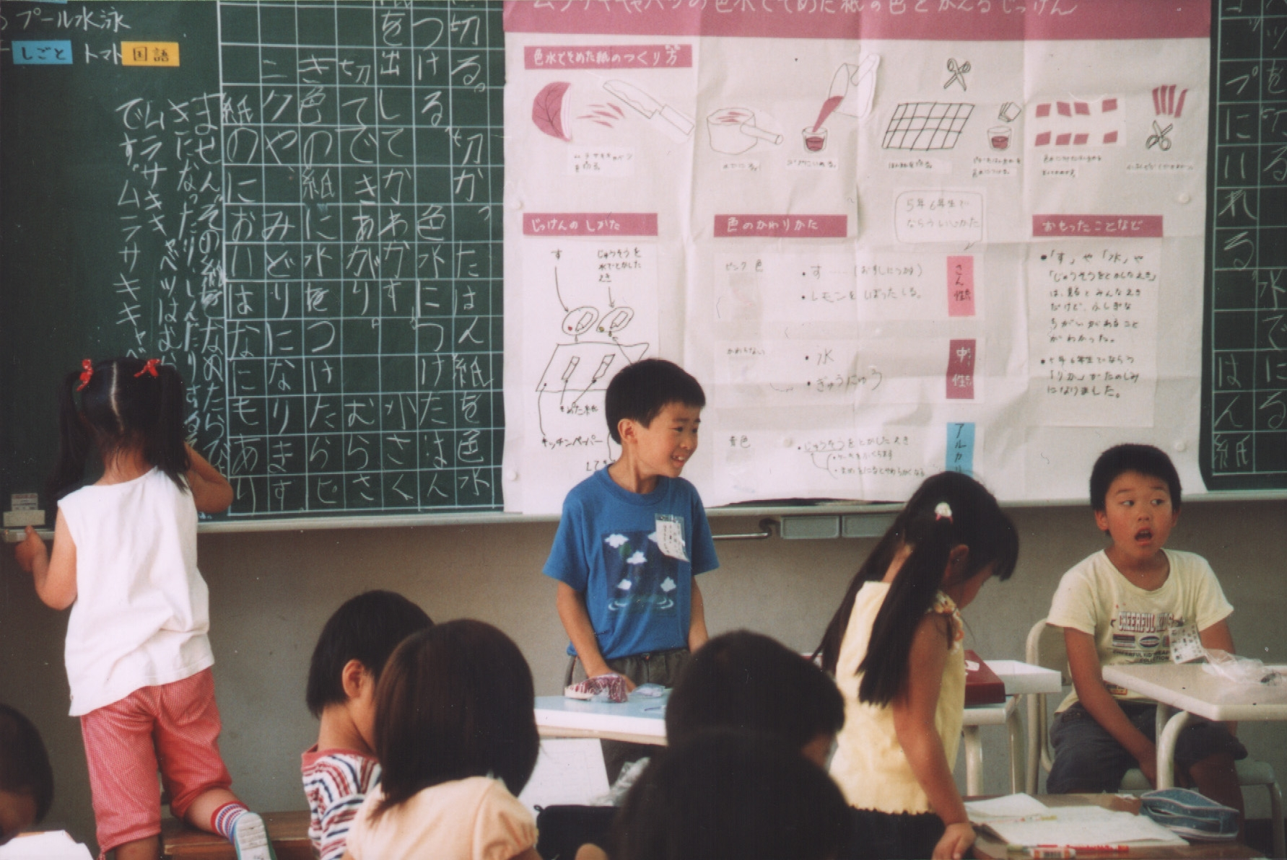
Japan develops R & L brain through formal talk activities & brain gym
In this school pupils teach to develop narrative language & thinking. They give a lesson overview, structure & review with each member sharing their view of the content in the final part of the class.

Slide 14
4. Teacher Role in Developing Narrative Ideas
7 Levels (Sage) Development Tasks: Topic – COPING WITH DISASTERS
RECORD – produce a range of ideas | List items for survival. Decide 3 most urgent to provide. Make a poster
RECITE - arrange ideas but not necessarily in order | What are your feelings & views about disasters? Arrange these on a poster
REFER – compare ideas- judge similarities/differences | Compare 2 message systems, e.g. Morse Code & Heliograph Make a poster
REPLAY - order ideas appropriately in time sequence | How do you revive a drowning person with ‘kiss of life’? Provide pictures & written instructions
RECOUNT – explain ideas – How? Why? | Alice is trapped & injured on a roof & water rising. She needs carrying to safety. Draw images - explain how to do a fireman’s lift. Why is it safe?
REPORT - introduce, describe & discuss ideas | Report on a disaster for a news programme. Tell a story with pictures - review situation
RELATE – produce ideas in a setting + events, actions, results, reactions | Choose a disaster picture -many on the web. Tell story - setting, events, results & reactions

Slide 15
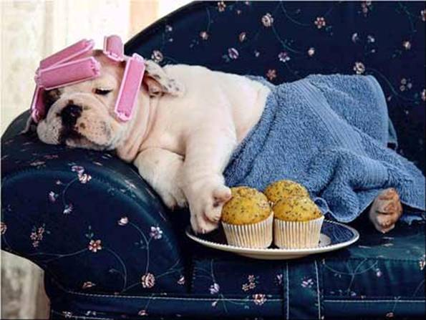

Resting my R & L brain! Present for all information processing ways & narrative levels
75% children & adults -limited thinking & communication
Give overview, structure & final review, with stories to aid understanding.
Present visuals first- then explain. 3 min. is limit for speech attention - break with tasks.
Only by sharing knowledge – are you aware of understanding it. Give time for learners to say what they have learnt from a session.
Articles to support:
E-learning not E-quality; Does Technology Help or Hinder; Reign of Error, Reign of Terror

